Slide 1



Database Management System
(203105251)
Prof. Atul Kumar , Assistant Professor
Computer Science & Engineering

Slide 2


CHAPTER-4
Transaction Processing

Slide 3
Locking and Time Stamp Based Schedulers
Whenever Multiple transactions are executed concurrently , It is exceptionally important to maintain concurrency between all of the concurrent transactions.
Concurrency Protocols can be used to maintain ACID properties of all transactions and they can be divided into two categories:-
(i) Lock Based Protocol
(ii) Time Stamp based Protocol

Slide 4
Lock Based Protocols
Lock based Protocol provides a mechanism which
Locks are of two types:-
(i) Lock Based Protocol
(ii) Time Stamp based Protocol

Slide 5
Lock Based Protocols (Continued….)
Lock based Protocols provide a mechanism in which any transaction cannot read or write data without suitable lock.
Locks are of two types:-
(i) Binary Locks:- A lock on data items can be in two states only, it will be either locked or unlocked.
(ii) Shared/exclusive:- This type of locking mechanism differentiates the locks based on their uses. If a lock is acquired on a data item to perform a write operation, it is an exclusive lock.

Slide 6
Lock Based Protocols (Continued….)
There are four types of lock protocols available −
(i) Simplistic Lock Protocol
(ii) Pre-claiming Lock Protocol
(iii) Two-Phase Locking 2PL
(iv) Strict Two-Phase Locking

Slide 7
Lock Based Protocols (Continued….)
(i) Simplistic Lock Protocol
(ii) Pre-claiming Lock Protocol
(iii) Two-Phase Locking 2PL
(iv) Strict Two-Phase Locking

Slide 8
Lock Based Protocols (Continued….)
(i) Simplistic Lock Protocol :-
It means lock must be obtained before every “write” operation and after completion of “write” operation transaction must release lock

Slide 9
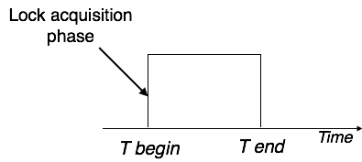
Lock Based Protocols (Continued….)
(ii) Pre-claiming Lock Protocol :-
This Protocol will create a list of database operation and after evaluating them ,Locks will be granted.
If all locks are granted , After completing all the database operations Transaction will release all the locks.

Slide 10
Lock Based Protocols (Continued….)
(iii) Two-Phase Locking 2PL:-
According to this protocol Execution phase will get divided into three parts as follows:
(a) Transaction will need permission to get a lock
(b) Transaction will acquire all the locks
After completion when transaction will release its 1st lock then 3rd phase will start
(c) Now Transaction cannot get a new lock it will release the acquired lock.

Slide 11
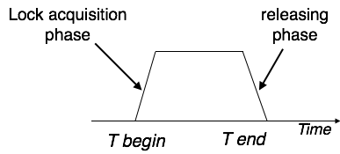
Lock Based Protocols (Continued….)
(iii) Two-Phase Locking 2PL (Continued…..)
This Process of acquiring and releasing lock is called as Growing and Shrinking Phase respectively.
In Growing Phase, Locks will get acquired.
In Shrinking Phase, Locks will get released.

Slide 12
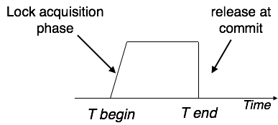
Lock Based Protocols (Continued….)
(iv) Strict Two-Phase Locking :-
According to this protocol Execution phase will get divided into three parts as follows:
(a) Transaction will need permission to get a lock and will acquire all the locks
(b) Now Transaction is not allowed to release any lock until commit (successful transaction) transaction.

Slide 13
Time Stamp Based Protocols (Continued….)
The timestamp-ordering protocol assures serializability between transactions in their conflict read and write operations. This is the liability of the protocol system that the conflict pair of tasks should be completed according to the timestamp values of the transactions.
The timestamp of transaction T_{i} is denoted as TS(T_{i}).
Read time-stamp of data-item X is denoted by R-timestamp(X).
Write time-stamp of data-item X is denoted by W-timestamp(X).

Slide 14
Time Stamp Based Protocols (Continued….)
Timestamp ordering protocol works as follows −
If a transaction Ti issues a read(X) operation −
  If TS(Ti) < W-timestamp(X)
    Operation rejected.
  If TS(Ti) >= W-timestamp(X)
    Operation executed.
  All data-item timestamps updated.
If a transaction Ti issues a write(X) operation −
  If TS(Ti) < R-timestamp(X)
    Operation rejected.
  If TS(Ti) < W-timestamp(X)
    Operation rejected and Ti rolled back.
  Otherwise, operation executed.

Slide 15
Multi Version Concurrency Control(MVCC)
MVCC will maintain more than one copy of same data item in order to avoid inconsistency.
Whenever An user will need to update a piece of data in transaction then it will overwrite a copy of data not original data.
MVCC allows POINT IN TIME CONSISTENT view. Read transactions under MVCC typically use a timestamp or Trans ID to decide which state of the database has to read, and read the particular versions of the data that is provided by MVCC.
Due to above approach Read and Write both will get executed at different data items (copies of maintained data).

Slide 16
Multi Version Concurrency Control(MVCC)
MVCC uses timestamp (TS), and incrementing transaction IDs, to attain consistency between transactions. MVCC assures a transaction (T) will never wait for Reading a database object (D) by maintaining several versions of the object. Each version of object D has both a Read Timestamp (RTS) and a Write Timestamp (WTS) which lets a specific transaction T_{i} read the most recent version of the object which precedes the transaction's Read Timestamp RTS(T_{i}).
f transaction T_{i} wants to Write to object D, and there is also another transaction T_{k} happening to the same object, the Read Timestamp RTS(T_{i}) must precede the Read Timestamp RTS(T_{k}), i.e., RTS(T_{i}) < RTS(T_{k}).

Slide 17
Optimistic Concurrency Control(OCC)
Optimistic concurrency control (OCC) is a concurrency control method applied to transactional systems such as relational database management systems and software transactional memory.
OCC provides a concept in which more than one transaction can frequently execute without interfering with each other.
During Execution, transactions utilize data resources without getting locks on those resources. Before committing, each transaction will verify that no other transaction has updated the data it has read. If the check confirms conflicting modifications, the committing transaction rolls back and will get restarted.

Slide 18
Optimistic Concurrency Control(OCC)
Phases of OCC:-
Begin: Save a timestamp by noting the transaction's beginning TS.
Modify: Read database values, and tentatively write changes.
Validate: Check whether other transactions have updated data that currently executed transaction has used (read or written). This includes transactions that completed after this transaction's start time, and optionally, transactions that are still active at validation time.
Commit/Rollback: If there is no conflict, make all changes take effect. If there is a conflict, resolve it.

Slide 19
Database Recovery
DBMS is a extremely complex system where thousands of transactions get executed each second. The resilience and robustness of a DBMS depends on its composite architecture and its underlying hardware and system software. If it fails or crashes during transactions, it is expected that the system would follow some sort of algorithm or techniques to recover lost data.
There are two types of errors can which leads to transaction failure:-
(a) Logical Error:- Code Error or any Query structure error
(b) System Error:- Error occurred due to system failure e.g. Deadlock
System Crash
Disk Failure

Slide 20
Database Recovery (Continued….)
Recovery and Atomicity
When a system crashes, there ma be a possibility that some of the transactions are getting executed and various files are opened for them to update the data items. Transactions are made of different operations, which must be atomic in nature. But according to ACID property of DBMS, atomicity must be maintained throughout the transaction.
Below points must be maintained in case of recovery from failure:-
It should verify the current state of all the transactions, which were in execution
A transaction may be in intermediate of some operation; the DBMS must assure the atomicity of the transaction in this case.
It should verify whether the transaction can be completed now or it needs to be rolled back.
No transactions would be allowed to leave the DBMS in an inconsistent state.

Slide 21
Database Recovery (Continued….)
Recovery and Atomicity
There are two types of techniques, which can help a DBMS in recovering as well as maintaining the atomicity of a transaction −
By Maintaining the logs of each transaction, and writing them onto in some storage and then modify the actual data.
Maintaining shadow paging.

Slide 22
Database Recovery (Continued….)
Log-based Recovery
Log is a list of records which are logically related, which stores the records of activities carried out by a transaction. It is important that the logs are written before actual modification and stored on a stable storage media, which must be safe.
Log-based recovery works as follows −
The log file is kept on a stable storage media.
When a transaction enters the system and starts execution, it writes a log about it.
<T_{n}, Start> When the transaction modifies an item X, it write logs as follows −
<T_{n}, X, V₁, V₂> It reads T_{n} has changed the value of X, from V₁ to V₂.
When the transaction finishes, it logs −
<T_{n}, commit>

Slide 23
Database Recovery (Continued….)
Recovery with Concurrent Transactions
When some transaction are getting executed in parallel, the logs are interleaved. At the moment of recovery, it will become tough to recover system to restore all logs, and then start recover. To ease this situation, most modern DBMS use the concept of 'checkpoints'.
Checkpoint
Checkpoint is a technique where all the previous logs are removed from the system and stored permanently in a storage disk. Checkpoint declares a point before which the DBMS was in consistent state, and all the transactions were committed.

Slide 24
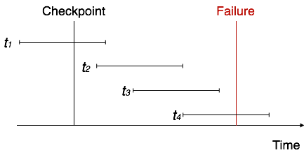
Database Recovery (Continued….)
Recovery with Concurrent Transactions
Transaction behave in following manner when it crashes and then recover:-
The system reads the logs backwards from the end to the last checkpoint.
It maintains two lists, an undo-list and a redo-list.
If the recovery system sees a log with <T_{n}, Start> and <T_{n}, Commit> or just <T_{n}, Commit>, it puts the transaction in the redo-list.
If the recovery system sees a log with <T_{n}, Start> but no commit or abort log found, it puts the transaction in undo-list.

Slide 25


www.paruluniversity.ac.in

